Slide 1
Language Education Policy in the Czech Republic
Václav Velčovský, Ph.D.
Vice-Minister for EU and ESIF
Ministry of Education, Youth, and Sports of the Czech Republic

Slide 2

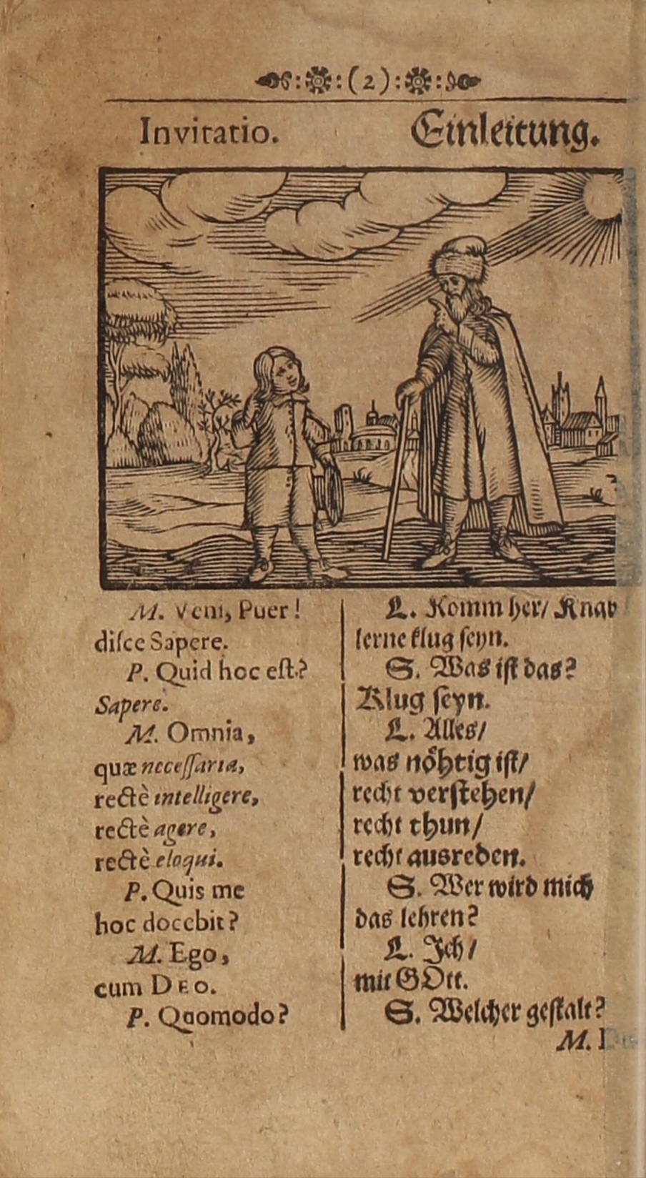
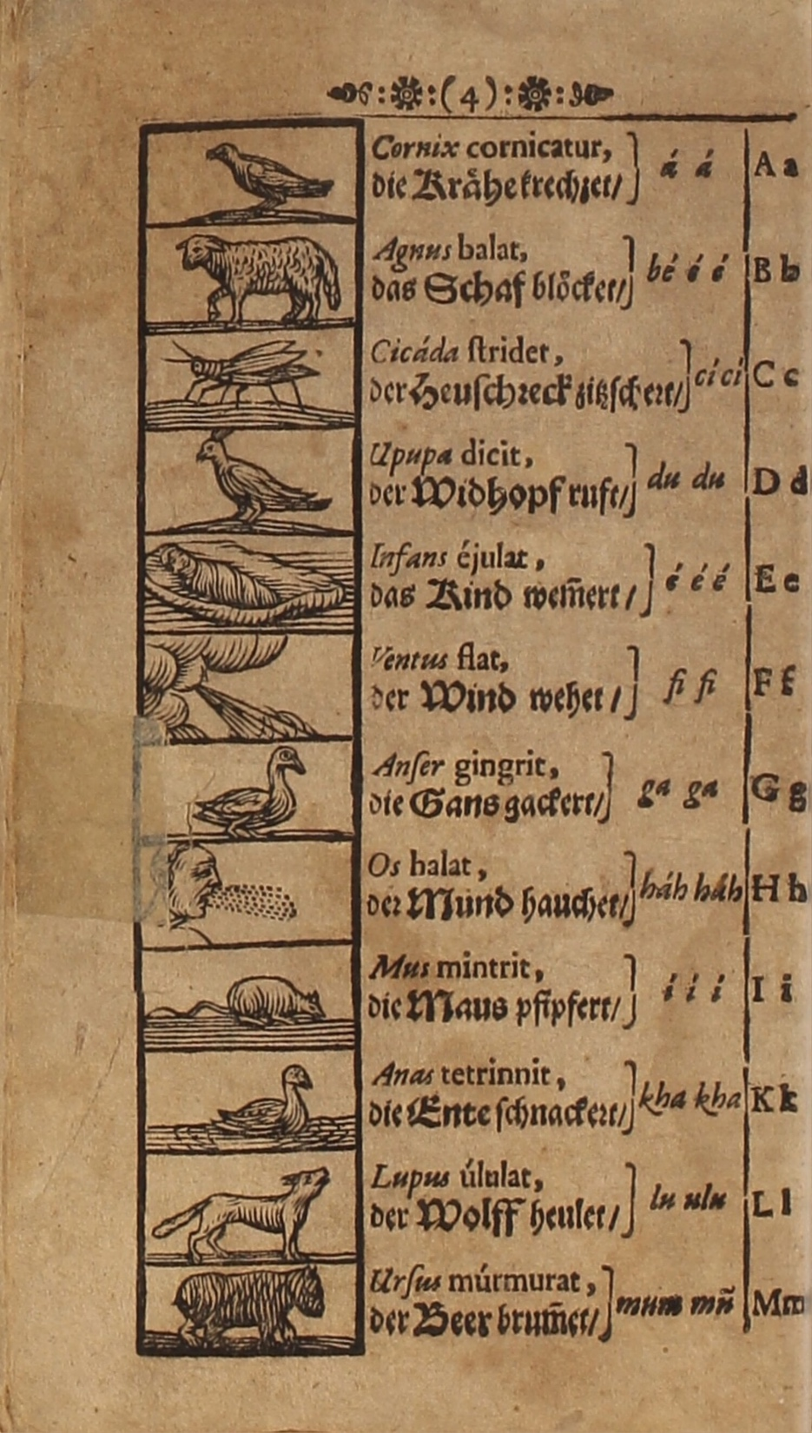

Slide 5
Robert Phillipson:
LINGUISTIC IMPERIALISM

Slide 6
Language education
The first foreign language on elementary school
(from the 3rd class, à 3 hours a week)
Since 2013/2014 the second foreign language compulsory on elementary school
(the 7th, 8th, 9th class of elementary school à 2 hours a week,
or the 8th, 9th class of elementary school à 3 hours a week,
exception possible)
Two foreign languages compulsory on the secondary school
(exception possible)

Slide 7
Elementary School - BEFORE 2013

Slide 8
Elementary School - AFTER 2013

Slide 9
Secondary School- BEFORE 2013

Slide 10
Secondary School - AFTER 2013

Slide 11
Support by the state
For Teachers:
Pedagogical and Didactical Methodology
Online support & Curricula
Further Teachers` Education
CLIL
Specific Projects / Subsidies
For Pupils:
Supportive Measures
Specific Projects / Subsidies
Bilingual Secondary Schools (ENG, DEU, ESP, ITA)

Slide 12
75 %

Slide 13
Foreigners
(in schools)
Citizen-, not national-state-conception
14 national minorities acknowledged by the state (CZ citizenship), specific financial support
5 % / 0,5M foreigners (no CZ citizenship)
      23 % UA
      22 % SK
      12 % VNM
      8 % RU

Slide 14
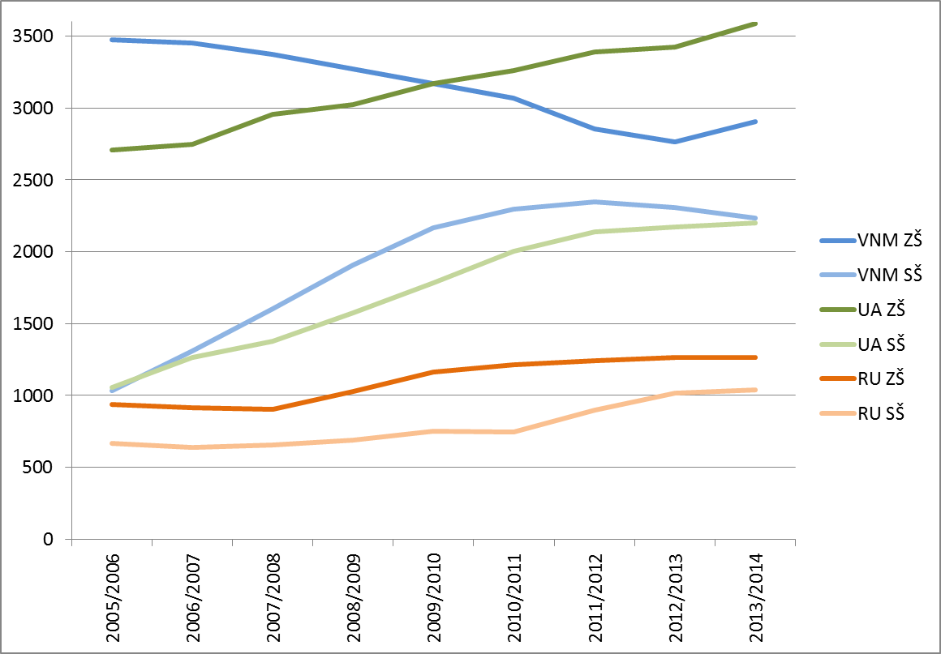

Slide 15
Foreigners` Integration
Permanent Residency in the Czech Republic
  A1, since 2021 A2
  Organized centrally by MEYS
Citizenship of the Czech Republic
  B1 + Knowledge of Society Test
  Organized by ALTE member (Charles University)
Online support on www.cestina-pro-cizince.cz
Regional schools: no proof of the Czech language knowledge – full inclusion
Universities: own regulation (Czech/English language programmes)

Slide 16
Citizenship of the Czech Republic
  2018: 99 % success in the Knowledge of Society Test
  2018: 78 % success in the B1 Czech Language Test

Slide 17
Tänan tähelepanu eest
Václav Velčovský, Ph.D.
Vice-Minister for EU and ESIF
Ministry of Education, Youth, and Sports of the Czech Republic
vaclav.velcovsky@msmt.cz
+420 778 743 888

