Slide 1
Communicating During COVID-19: What We Know So Far, and How It Matters
Dr William L Allen | @williamlallen
Department of Politics and International Relations, University of Oxford
Centre on Migration, Policy, and Society (COMPAS)
St John’s College

Slide 2
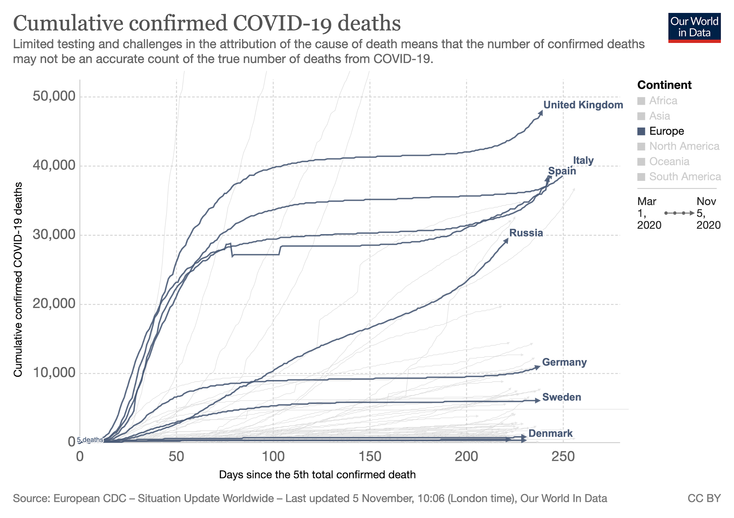

Slide 3
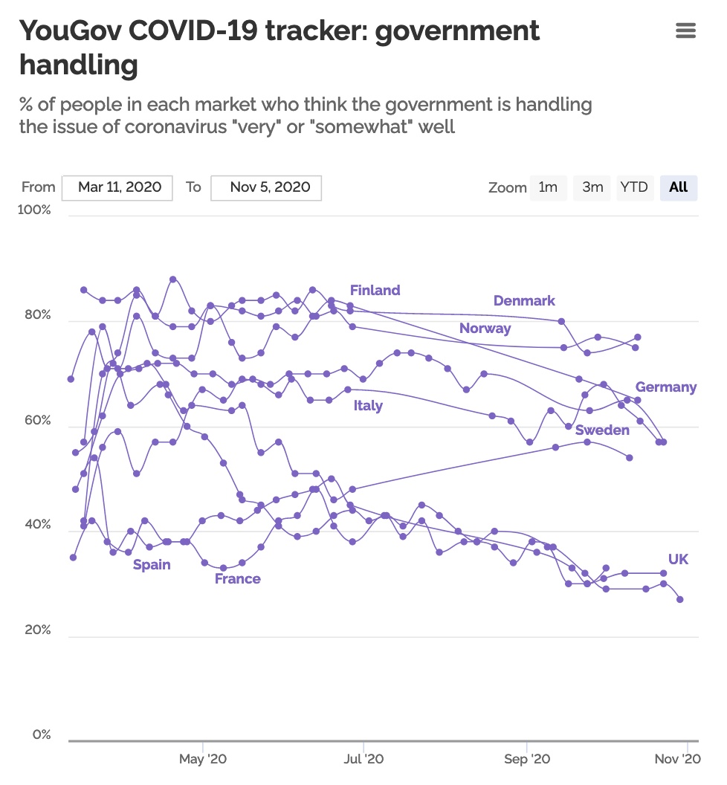
Source: YouGov UK

Slide 4
Communication and Public Attitudes in Crises
Views on COVID-19 and interventions are increasingly polarized
Elite cues from politicians contribute to these views
Concerns about an “info-demic” due to mis- and dis-information

Slide 5
Attitudes about Migration and Diversity
Public attitudes on immigration tend to prioritize skilled occupations, education, strong command of host country language
National responses to COVID-19 could shift perceptions of essential or key workers—many of whom are foreign-born
In the UK: health professions (26.9% foreign-born); nursing professionals (22.1%); caring and personal services (18.9%); road transport (17.9%) [source: Labour Force Survey 2019, average of four quarters, waves 1 and 5]

Slide 6
Communicating Immigration: Different Approaches
Communication strategies potentially matter for impacting attitudes and public understanding of migrants’ impacts
Forms of information (numbers, narratives, visuals)
Types of concerns (economic, social/cultural impacts)

Slide 7
Why This Matters—Especially Now
Both COVID-19 and migration/diversity are likely to remain highly salient (and related) issues for governments, civil societies, and local communities
Communication is a crucial way to potentially impact public attitudes, consent for, and trust in public health and integration interventions

Slide 8
Communicating During COVID-19: What We Know So Far, and How It Matters
Dr William L Allen | @williamlallen
Department of Politics and International Relations, University of Oxford
Centre on Migration, Policy, and Society (COMPAS)
St John’s College

